Slide 1
Introduction to Data Analytics
Lecture 5
Professor Pottenger

Slide 2
Moving on: Engineering the input and output

Slide 3
Applying a learner is not all
Already discussed: scheme/parameter selection
Important: selection process should be treated as part of the learning process
Modifying the input: attribute selection, discretization, data cleansing, transformations
Modifying the output: combining classification models to improve performance
Bagging, boosting, stacking, error-correcting output codes (and Bayesian model averaging)
Notes:
it is tempting to try out several learning schemes and parameter values and choose the best. But the best choice is sometimes not the one that performs best on the training data (overfitting)
Solution: 2 good methods for estimating the expected true performance of a learning scheme: when have plentiful data use a large dataset separate from training data; when scarce data use cross validation
To see how well it performs, you need an "inner" cross validation for parameter tuning and an "outer" cross validation for error estimation.
There are 6 different ways in which the input can be massaged to make it more amenable for learning: attribute selection*, attribute discretization*, data projections, sampling, data cleansing*, and converting multi class problems to 2-class ones*.
Attribute selection: too many attributes, some are redundant or irrelevant. Preprocessing data to choose the best ones. (Many learning schemes try to do this, but their performance can be improved by pre selection. E.g. Decision trees and rules, linear regression, instance based learners, and clustering methods have been shown in experiments to have performance deteriorate when adding useless attributes.)
Discretization of numeric attributes is essential if the dataset involves numeric data but learning scheme can only handle categorical data
Transformations: one example is to add new synthetic attributes whose purpose is to present existing information in a form more suited for the machine learning scheme to pick up on
Data cleaning: we talked about a lot in a prior lecture, but important to understand the meaning of the attributes, significance in missing values or duplicate entries, noise, data errors and systemic errors. There are automatic methods of cleansing, such as detecting outliers, including one class learning where only a single class of instances is available at training time (e.g. Nuclear detection data where we learned on one isotope class at a time)

Slide 4
Attribute selection
Adding a random (i.e., irrelevant) attribute can significantly degrade C4.5’s performance
Problem: attribute selection based on smaller and smaller amounts of data
IBL is also very susceptible to irrelevant attributes
Number of training instances required increases exponentially with number of irrelevant attributes
Naïve Bayes doesn’t have this problem
Relevant attributes can also be harmful
Notes:
Decision tree learners such as C4.5 should never split on irrelevant or unhelpful attributes (remember information gain, etc)
Experiments have shown that when adding a random binary attribute generated by tossing a coin, performance deteriorates by 5-10% because the irrelevant attribute is invariably chosen to branch on, causing random errors when the test data is processed. As you progress down the tree, less and less data is available to help make the selection decision. At some point, with little data, the random attribute will look good by chance. Because the number of nodes at each level increases exponentially with depth, the chance of the attribute looking good multiplies as the tree deepens. (If the data was bigger, it would probably just happen further down the tree.)
Instance based learners are also susceptible because they also work in local neighborhoods
Relevant attributes can also be harmful. E.g. In a 2-class problem,suppose a new attribute was added that had the same values of the class to be predicted 65% and opposite values the rest of the time. This can cause accuracy to deteriorate by 1-5% . The problem is that the new attribute is chosen for splitting high up in the tree, which then fragments the set of instances further down the tree so that future choices are based upon less data
The best way to select attributes is manually based on understanding of the data.

Slide 5
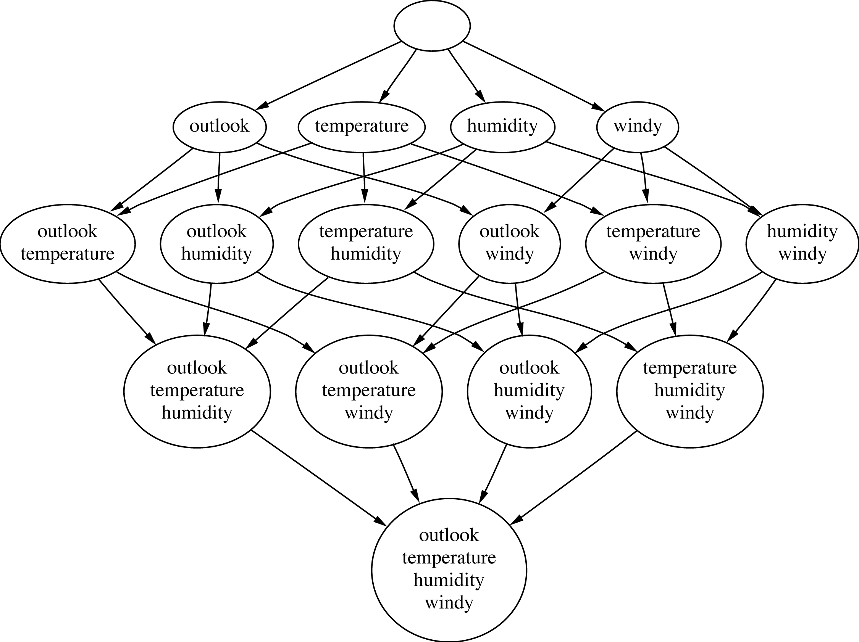
Attribute subsets for weather data

Slide 6
Searching the attribute space
Number of possible attribute subsets is exponential in the number of attributes
Common greedy approaches: forward selection and backward elimination
More sophisticated strategies:
Bidirectional search
Best-first search: can find the optimum solution
Beam search: approximation to best-first search
Genetic algorithms
All approaches need a fitness metric (i.e., definition of ‘good’ or ‘right’)
Could be 10-fold CV performance
Notes:
Most attribute selection methods involve searching the space of attributes for the subset that is most likely to predict the class best.
Typically we use a greedy approach, in either top to bottom (forward selection) or bottom to top (backward selection)
Forward selection: each attribute that's not already in the current subset in tentatively added, and the resulting set of attributes is evaluated (e.g. With cross validation). This produces a numeric measure of the expected performance of the subset. The effect of adding each attribute is quantified by this measure, the best one is chosen, and then continues. If no attribute produces an improvement when added, the search ends. As with greedy approaches, his guarantees a local optimum set of attributes but maybe not a global one.
DESCRIBE GREEDY ALGORITHMS AND A GENERIC EXAMPLE
In both forward and backward selection, there is a slight bias toward smaller attribute sets
Can require not just an increase in performance, but at least a minimum amount of increase
Bidirectional: starting with all or none of the attributes (like forward and backward elimination)
Best-first: doesn't just terminate when performance starts to drop, but keeps a list of all attribute subsets evaluated so far, sorted in order of performance measure so that it can revisit an earlier configuration. Given enough time it will explore the entire procedure unless you give it stopping criteria. Q: issues w this?? (Run time)
Beam: similar, but truncated the list of attributes at each stage so that it only contains a fixed number (beam width) of the most promising candidates
Genetic algorithm: loosely based on principle of natural selection: evaluate "good" feature subsets by using random variations of the current list of candidate subsets and comvines them based on performance
In general, backward elimination produces larger attribute sets but better classification accuracy than forward selection

Slide 7
Scheme-independent selection
Filter or open loop approach: assessment based on general characteristics of the data (does not involve repeated learning)
One method: find subset of attributes that is enough to separate all the instances
Another method: use different learning scheme (e.g., C4.5, 1R) to select attributes
IBL-based attribute weighting techniques can also be used (this is the normal way IBL works, but as noted can’t find redundant attributes)
Correlation-based (statistical) evaluation of subsets
Symmetric uncertainty based on entropy
Notes:
When selecting a good attribute subset, there are two fundamentally different approaches
1. The filter method: make an independent assessment based on general characteristics of the data. The attribute set is filtered to produce the most promising subset prior to learning
The next we will talk about shortly
One scheme-independent method of attribute selection is to use just enough attributes to divide up the instance space in a way that separates all the training instances. (e.g. if just 1 or 2 attributes used, there will generally be several instances that have the same combination of attribute values) (e.g. other extreme is that no two instances have the same attribute values. But remember, sometimes instances contain the same attribute values but different classes.)
You can also use a different learning scheme to select attributes. E.g. first apply decision tree algorithm (C 4.5 or 1R) to the full dataset and then select only those attributes only used in the tree. This would have no effect if the second stage was to just build another tree, but it will have an effect on a different learning algorithm.
You can also use instance based learners also.You can sample instances randomly from the training set and check neighboring records of the same and different classes (near hits and near misses). (If a near hit has a different value for a certain attribute, that attribute is irrelevant and its weight is decreased. If a near miss has a different value, the attribute is relevant and its weight is increased.) After repeating many times, only attributes with positive weights are chosen. (pg 310)
A disadvantage is that the method will not detect an attribute that is redundant because its correlated with another attribute.

Slide 8
Scheme-specific selection
Wrapper or closed loop approach: attribute selection implemented as wrapper around learning scheme
Evaluation criterion: as before, CV performance
Time consuming: adds factor of 2^{k} – 1 for exhaustive search approaches with k attributes
sum(k choose 1, k choose 2, …, k choose k)
Linearity in k requires prior ranking of attributes
Scheme-specific attribute selection essential for learning decision tables
Is efficient for decision tables and Naïve Bayes
Algorithms not complex => CV computation less complex
Notes:
When selecting a good attribute subset, there are two fundamentally different approaches
1. The filter method: make an independent assessment based on general characteristics of the data. The attribute set is filtered to produce the most promising subset prior to learning
2. The wrapper approach: evaluates the subset using the machine learning algorithm that will ultimately be employed for learning. It is called the wrapper method because the learning algorithm is wrapped into the selection procedure. Making an independent assessment of an attribute subset would be easy if there were a good way of determining when an attribute was relevant to choosing the class. (But there’s no universally accepted measure of relevance.)
A simple method of speeding up a scheme-specific search is to preselect a given number of attribtues by ranking them first using a criterion like information gain and discarding the rest before applying scheme specific selection.
Sceheme-specific attribute selection essential for learning decision tables. Remember, the entire problem of learning decision tables consists of choosing the right attributes to be included. Usually done by measuring the table’s cross-validation performance for different subsets of attributes and choosing the best performing subset. Leave one out cross validation is cheap for this.
NB has good results shown with forward selection attribute selection (which is better able to detect when a redundant attribute is about to be added than backwards elimination) in conjunction with a very simple “naïve” metric that determines the quality of an attribute subset to be simply the performance the learned algorithm on the training set.
Think about how a decision table approach would work on the class schedule published during registration… each time an attribute is removed, the performance of the table is measured. We can think of using the table to ‘predict’ the day/time of a given class. However, since the course number (e.g., CSE 347), name (e.g., Data Mining) and CRN basically duplicate the same information, any one of the three (e.g., class name “Data Mining”) could be removed by a decision table algorithm and the performance checked to ensure that it did not change. This could be repeated for a second attribute (e.g., class number “CSE 347”), and performance tested again. This iterative process naturally involves removing attributes and testing the performance of the resulting table. This exemplifies a scheme-specific attribute selection mechanism that is ‘built-in’ to a learning algorithm.

Slide 9
Discretizing numeric attributes
Can be used to avoid making normality assumption in Naïve Bayes and Clustering
Recall the simple (global) discretization scheme used in 1R
C4.5, however, performs local discretization
Global discretization can be advantageous because it’s based on more data
Learner can be applied to discretized attribute using nominal attributes or
Learner can be applied to order-preserving binary attributes coding the intervals in the discretized attribute
Relational tests can be employed to leverage the order
Notes:
Some classification and clustering algorithms deal with nominal attributes only and cannot handle ones measured on a numeric scale. To use them on a general dataset, numeric attributes must be first “discretized” into a small number of distinct ranges.
Statistical clustering methods often assume that numeric attributes have a normal distribution (which is not always the case) and the standard extension of NB adopts the same assumption
Most decision trees and decision rule learners can handle numeric values, some implementations work much slower when numeric attributes are present because they are repeatedly sorting the attribute values.
1R uses a simple technique: sort instances by attribute’s value and assign the value into ranges at the points that the class value changes (except that a minimum number of instances in the majority class must lie in each of the ranges, which means that any given range may include a mixture of class values). This is a “global” method of discretization
Decision trees deal with numeric attributes on a local basic, examining attributes at each node of the tree when it’s constructed to see if it;’s worth branching on, and only at that point deciding on the best place to split continuous attributes.
Local discretization is tailored to the actual context provided by each tree node and will produce different discretizations of the same attribute at different places in the tree if that seems appropriate. However, its decisions are based on less data as tree depth increases, which compromises their reliability.
Global discretization can be done in two ways: 1. treat discretized attributes like nominal ones: each discretization interval is represented by one value of the nominal attribute (disregards ordering of values). 2. If the learning scheme can’t handle ordered attributes, transform each discretized attribute into a set of binary attributes before the learning scheme is applied. If the discretized attribute has k values, it’s transformed into k-1 binary attributes. If the original attribute’s value is I, the first i-1 values are treated as FALSE and the remainder are set to TRUE.

Slide 10
Unsupervised discretization
Unsupervised discretization generates intervals without looking at class labels
Only possible way with unsupervised learning, e.g., clustering
Two main strategies:
Equal-interval binning
Use pre-defined number of equal intervals/bins
Distribution of number of instances and classes may vary widely
Equal-frequency binning (also called histogram equalization)
Choose intervals/bins such that same number of instances fall in each
Use pre-determined number of bins
Distribution of classes may vary widely
Inferior to supervised schemes in classification tasks
Notes:
Equal interval binning – often distributes instances very unevenly – some bins contain many instances and some contain none
Often better to let the bins be different sizes – called Equal Frequency Binning. This divides the attribute’s range into a predetermined number of bins based on the distribution of examples along that axis. But this can also be oblivious to an instance’s classes, and can cause bad boundaries. (e.g. if all instances in one bin all have the same class, and all instances in the next highest bin have another except for the first, which has the original class, then it makes sense to respect the class divisions and include that first instance in the first bin, sacrificing the equal-frequency property.

Slide 11
Entropy-based discretization
Entropy-based discretization is a supervised method that builds a decision tree after pre-pruning attributes based on the result of discretization
Entropy used as splitting criterion
MDLP used as stopping criterion
State-of-the-art discretization method
Application of MDLP:
“Theory” is the splitting point (up to log₂(N) bits where N is the number of instances in the set of instances under consideration) plus the errors of class distribution in each subset
DL before/after adding splitting point is compared

Slide 12
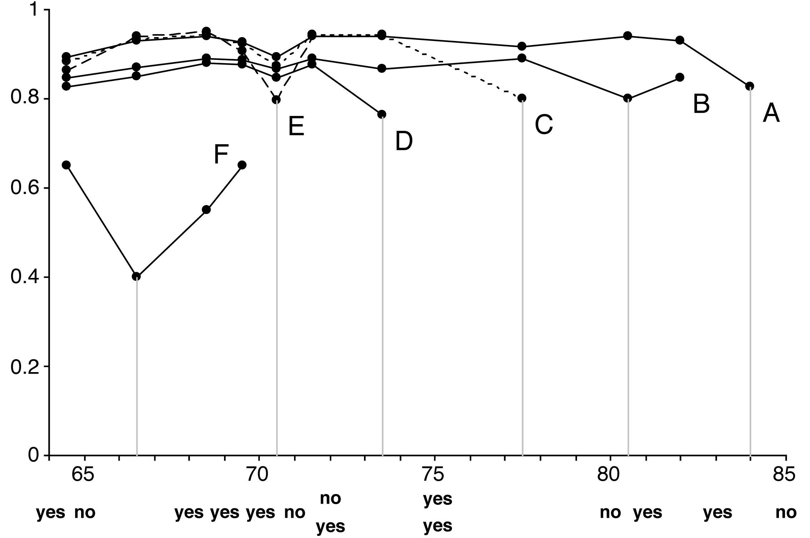
Example: temperature attribute
At point A the entropy is: info([9,4],[0,1]) =
(13/14) ∙ info(9,4) + 1/14 ∙ info(0,1) = 0.827
Notes:
Calculate information gain for each of the 11 possible positions (between each of the 12 possible values) (pg 317). We seek the split where the subintervals are the most pure, so we want the smallest value of information (or similarly where information gain is the largest).
This graph at A is the information values at each possible cut point in the first stage. Smallest information value is at 84 (.827 bits), separating just the last value
Invoking a second time on the remaining ranges, we get B., with a minimum at 80.5 (.800 bits)
Now we invoke C from 64 to 80, and get a minimum of 77.5 (.801 bits), splitting off a no instance
D has a minimum at 73.5 (.764 bits) splitting off two yes instances
E is for range 64-72, has a minimum at 70.5 (.796 bits)
F is for the range 64 to 70 and has a minimum at 66.5 (.4 bits)
We can show this in a chart as in next slide
Note that in general, subintervals both to the left and right of a split point will be recursively evaluated – the fact that only subintervals to the left of each split point were recursively split is an artifact of this particular dataset.

Slide 13
Temperature attribute final result
Table below shows the final result of entropy-based discretization for the temperature attribute
64 65 68 69 70 71 72 75 80 81 83 85
no yes
yes no yes yes yes no no yes yes no
yes yes
F E D C B A
66.5 70.5 73.5 77.5 80.5 84

Slide 14
Formula for MDLP
N instances in a given subset and
k classes and entropy E in original instance set
k₁ classes and entropy E₁ in left subset
k₂ classes and entropy E₂ in right subset
Doesn’t result in any discretization intervals for the temperature attribute (i.e., pre-pruning, a form of attribute selection!)
Notes:
A good way to stop the entropy-based splitting discretization procedure turns out to be the Minimum Description Length Principle
We want to minimize the size of the theory plus the size of the information necessary to specify all of the data given that theory.
In this case, if we do split, the theory is the splitting point, and we are comparing the situation in which we split with that in which we do not
The first component in the MDLP formula above is the information needed to specify the splitting point; the second component is the information needed to transmit the distribution of classes in the left/right subintervals of the split.

Slide 15
Other discretization methods
Top-down procedure can be replaced by bottom-up method that merges intervals
MDLP can be replaced by chi-squared test
Dynamic programming can be used to find optimum k-way split for given additive criterion
Requires time quadratic in number of instances if entropy is used as criterion
Can be done in linear time if error rate is used as evaluation criterion
Notes:
Pg 320

Slide 16
Automatic data cleansing
Improving decision trees: relearn tree with misclassified instances removed
Better strategy (of course): let human expert check misclassified instances
When systematic noise is present it’s better not to modify the data (either test or training)
Also: attribute noise should be left in training set
(Unsystematic) class noise in training set should be eliminated if possible
Notes:
-A big problem is data quality. Remember our lecture on this? What are some examples of poor data quality? What are you seeing with this in your own projects? How are you dealing with repairing this data quality??
What is a systematic error? (one class commonly mis-substituted for another.) Are you seeing this in your projects?
In this case, it’s better to leave as-is
It’s been shown that when artificial noise has been added to attributes (rather than to classes), test set performance is improved if the same noise is added in the same way to the training set. (don’t train on a “cleaned” set if the test set is ripe with systemic errors)
With class noise, it is best to train on noise-free instances is possible

Slide 17
Detecting anomalies
Visualization best way of detecting anomalies (but often can’t be done)
Automatic approach: committee of different learning schemes
E.g. decision tree, nearest-neighbor learner, and a linear discriminant function
Conservative approach: only delete instances which are incorrectly classified by all of them
Problem: might sacrifice instances of small classes
Notes:
Without consulting a SME, there’s no real way to determine if something is actually an error or anomaly or not
Sometimes visually apparent if wrong type of curve is applied to data (in statistical regression)
But most classification problems cant be so easily visualized
One way is to ask three models to classify the same data, and if they all mis-classify the same instance, then it’s erroneous and removed.
End at pg 335

Slide 18
Combining multiple models
Basic idea of “meta” learning schemes: build different “experts” and let them vote
Advantage: often improves predictive performance
Disadvantage: produces output that is very hard to analyze
Schemes we will discuss: bagging, boosting, and stacking
These techniques can be applied to both classification and numeric prediction problems
Notes:
-start at pg 351 (ch 8)

Slide 19
Bagging
Employs simplest way of combining predictions: voting/averaging
Each model receives equal weight
“Idealized” version of bagging:
Sample several training sets of size n (instead of just having one training set of size n)
Build a classifier for each training set
Combine the classifier’s predictions
This improves performance in almost all cases if learning scheme is unstable
E.g., decision tree induction which is sensitive to small changes in the input
Notes:
Combining decisions of different models means combining the various outputs into a single prediction
Simplest way is to take a vote; or in numeric prediction to take the average
Models receive equal weight
Suppose that several training datasets of the same size are chosen at random from the data. Imagine for a particular machine learning technique to build a decision tree for each dataset. You’d expect these to be nearly the same and to make the same prediction for each new test instance. Surprisingly, this assumption is usually quite wrong, especially if the datasets are small. Slight changes to the training data may result in a different attribute being chosen at a particular node.

Slide 20
Bias-variance decomposition
Theoretical tool for analyzing how much specific training set affects performance of classifier
Assume we have an infinite number of classifiers built from different training sets of size n
The bias of a learning scheme is the expected error of the combined classifier on new data
The variance of a learning scheme is the expected error due to the particular training set used
Total expected error: bias + variance
Notes:
The effect of combining multiple hypothesis can be viewed through a theoretical device known as bias-variance decomposition.
Suppose we could have an infinite number of independent training sets of the same size and use them to make an infinite number of classifiers. A test instance is processed by all classifiers, and a single answer is determined by majority vote. In this idealized situation, errors will still occur because no learning scheme is perfect. The error rate will depend on how well the machine learning method matches the problem at hand, along with the effect of the noise on the data.
(Noise is included in the bias term, as it is generally unknown in practice how much noise there really is)
Variance is the expected error from the training set used (as it may not be perfectly representative of the data) over all possible training sets of the given size and all possible test sets
Total expected error is the bias-variance decomposition

Slide 21
More on bagging
Bagging reduces variance by voting/averaging, thus reducing the overall expected error
In the case of classification there are pathological situations where the overall error might increase
Usually, the more classifiers the better
Problem: we only have one dataset!
Solution: generate new datasets of size n by sampling with replacement from original dataset
Bagging = Bootstrap + Aggregating
Can help a lot if data is noisy
Notes:
-

Slide 22
Bagging classifiers
model generation
Let n be the number of instances in the training data.
For each of t iterations:
Sample n instances with replacement from training set.
Apply the learning algorithm to the sample.
Store the resulting model.
classification
For each of the t models:
Predict class of instance using model.
Return class that has been predicted most often.

Slide 23
Boosting
Also uses voting/averaging but models are weighted according to their performance
Iterative procedure: new models are influenced by performance of previously built ones
New model is encouraged to become expert for instances classified incorrectly by earlier models
Intuitive justification: models should be experts that complement each other
There are several variants of this algorithm
Notes:
Boosting also combines different models, but tries to find ones that complement each other
Like bagging, uses voting/averaging; also uses models of the same type (like decision trees)
However, it is iterative
In bagging, models are built separately, in boosting, each new model is influenced by performance of those built previously
Boosting weights models according to their confidence

Slide 24
AdaBoost.M1
model generation
Assign equal weight to each training instance.
For each of t iterations:
Apply learning algorithm to weighted dataset and store
resulting model.
Compute error e of model on weighted dataset and store error.
If e equal to zero, or e greater or equal to 0.5:
Terminate model generation.
For each instance in dataset:
If instance classified correctly by model:
Multiply weight of instance by e / (1 - e).
Normalize weight of all instances.
classification
Assign weight of zero to all classes.
For each of the t (or less) models:
Add -log(e / (1 - e)) to weight of class predicted for instance by model.
Return class with highest weight.
AdaBoost.M1 assumes instances in training set are weighted
Notes:
Can be applied to any classification learning algorithm
Assume the model can handle weighted instances (where the weight of an instance is a positive number)
The classification’s error is calculated as the sum of the weights of the misclassified instances divided by the total weight of all instances
Focus on a particular set of instances with high weight
(C4.5 can accommodate weighted instances without modification because it already uses the notion of fractional instances to handle missing values.)

Slide 25
More on boosting
Can be applied without weights using resampling with probability determined by weights
Disadvantage: not all instances are used
Advantage: resampling can be repeated if error exceeds 0.5
Stems from computational learning theory
Theoretical result: training error decreases exponentially
Also: works if base classifiers not too complex and their error doesn’t become too large too quickly
Notes:
-Disadvantage is that some instances with low weight don’t make it into resampled dataset, so information is lost before the learning scheme is applied. However, this can turn into an advantage. If the learning scheme produces a classifier with an error > 0.5, boosting must terminate if the weighted data is used directionally, whereas with resampling it might be possible to produce a classifier with an error below 0.5 by discarding the resampled dataset and generating a new one from a different random seed.

Slide 26
A bit more on boosting
Puzzling fact: generalization (test set) error can decrease long after training error has reached zero
Seems to contradict Occam’s Razor!
However, problem disappears if margin (confidence) is considered instead of error – margin is difference in estimated probability of true class vs. most likely incorrectly predicted class
Boosting can increase margin long after training set error = 0
Boosting works with weak learners: only condition is that error doesn’t exceed 0.5
E.g., decision stump
LogitBoost: more sophisticated boosting scheme for multiclass problems
Notes:
The idea of boosting originated in a branch of machine learning known as computation learning theory.
Theoreticians are interested in boosting because it is possible to derive performance guarantees; e.g. it can be shown that the error of the combined classifier on the training data approaches 0 very quickly as more iterations are performed
Occam’s Razor: of two hypotheses that explain the empirical evidence equally well, the simpler one is to be preferred
Pg 361
Good results for two class problems can often be obtained by boosting extremely simple decision trees that only have one level (decision stump)

Slide 27
Stacking
Hard to analyze theoretically: “black magic”
Uses meta learner instead of voting to combine predictions of base learners
Predictions of base learners (level-0 models) are used as input for meta learner (level-1 model)
Base learners usually different learning schemes
Predictions on training data can’t be used to generate data for level-1 model!
Cross-validation-like scheme is employed
Notes:
-pg 369
-stacking generalization or stacking is a different way of combining multiple models
-less widely used than bagging and boosting because it is difficult to analyze theoretically and partly because there is no generally accepted best way of doing it
-it Is not normally used to combine models of the same type
Instead it is applied to models built by different learning algorithms
-introduces the concept of meta learner instead of voting/averaging
Stacking tries to learn which classifiers are the reliable ones, using another learning algorithm (the meta learner) to discover how best to combine the output of the base learners
-the input to the meta learners (level 1) are the predictions of the base models (level 0)

